Slide 1


Working of
Neural Networks

Slide 2
RECAP

Slide 3
Hidden Layers
Input
Output
Number of weights

Slide 4
Hidden Layer
Input
Output
2 * 1
2 * 3

Slide 5
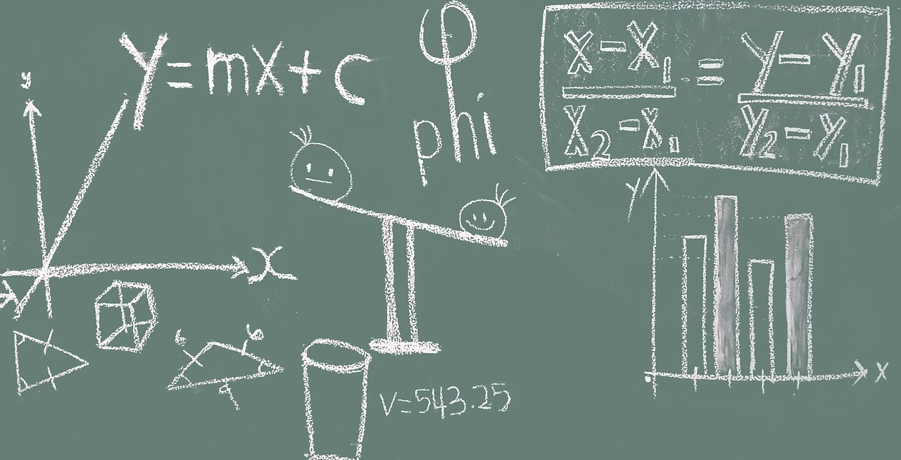
Math of Neural Networks

Slide 6
x₁ | x₂ | y
1 | 2 | 3
Requirement Data

Slide 7
Hidden Layer
Input
Output
1
2

Slide 8
Hidden Layer
W₁₁₁ =0.5
Input
W₁₁₂ =0.3
Output
1
2

Slide 9
h₁₁ = xW + b
W₁₁₁ =0.5
Input
W₁₁₂ =0.3
Output
1
2

Slide 10
h₁₁ = 1 * 0.5 + 2 * 0.3 + 1
W₁₁₁ =0.5
Input
W₁₁₂ =0.3
Output
1
2

Slide 11
h₁₁
2.1
W₁₁₁ =0.5
Input
W₁₁₂ =0.3
Output
1
2

Slide 12
h₁₁
2.1
o₁₁ = sigmoid(h₁₁)
W₁₁₁ =0.5
Input
W₁₁₂ =0.3
Output
1
2

Slide 13
h₁₁
2.1
o₁₁ = 0.89
W₁₁₁ =0.5
Input
W₁₁₂ =0.3
Output
1
2

Slide 14
h₁₁
2.1
o₁₁ = 0.89
W₁₁₁ = 0.5
Input
W₁₁₂ =0.3
h₂₁
Output
1
2
W₁₂₁ = 0.15
1.95
o₁₂ = 0.875
W₁₂₂ = 0.4

Slide 15
h₁₁
2.1
o₁₁ = 0.89
W₁₁₁ = 0.5
Input
W₁₁₂ =0.3
h₂₁
Output
1
2
W₁₂₁ = 0.15
1.95
o₁₂ = 0.875
W₁₂₂ = 0.4
W₁₃₁ = 0.65
h₁₃
1.05
W₁₃₂ = -0.3
o₁₃ = 0.741

Slide 16
h₁₁
2.1
o₁₁ = 0.89
W₁₁₁ = 0.5
W₁₁₂ =0.3
Output = 0.89* -0.23 + 0.875 * 0.83 + 0.741 * -0.56 + 1
Input
h₂₁
W₂₁₁ = -0.23
1
2
W₁₂₁ = 0.15
1.95
o₁₂ = 0.875
W₂₁₂ = 0.83
W₁₂₂ = 0.4
W₂₁₃ = -0.56
W₁₃₁ = 0.65
h₁₃
1.05
W₁₃₂ = -0.3
o₁₃ = 0.741

Slide 17
h₁₁
2.1
o₁₁ = 0.89
W₁₁₁ = 0.5
Input
W₁₁₂ =0.3
h₂₁
W₂₁₁ = -0.23
Output
1
2
W₁₂₁ = 0.15
1.95
o₁₂ = 0.875
W₂₁₂ = 0.83
1.106
W₁₂₂ = 0.4
W₂₁₃ = -0.56
W₁₃₁ = 0.65
h₁₃
1.05
W₁₃₂ = -0.3
o₁₃ = 0.741

Slide 18
h₁₁
2.1
o₁₁ = 0.89
W₁₁₁ = 0.5
Input
W₁₁₂ =0.3
h₂₁
W₂₁₁ = -0.23
Output
1
2
Loss
W₁₂₁ = 0.15
1.95
o₁₂ = 0.875
W₂₁₂ = 0.83
1.106
(Prediction - Actual)²/2
W₁₂₂ = 0.4
W₂₁₃ = -0.56
W₁₃₁ = 0.65
h₁₃
1.05
W₁₃₂ = -0.3
o₁₃ = 0.741

Slide 19
h₁₁
2.1
o₁₁ = 0.89
W₁₁₁ = 0.5
Input
W₁₁₂ =0.3
h₂₁
W₂₁₁ = -0.23
Output
1
2
Loss
W₁₂₁ = 0.15
1.95
o₁₂ = 0.875
W₂₁₂ = 0.83
1.106
(1.106 - 3)²/2
= 1.793
W₁₂₂ = 0.4
W₂₁₃ = -0.56
W₁₃₁ = 0.65
h₁₃
1.05
W₁₃₂ = -0.3
o₁₃ = 0.741

Slide 20

How do we update weights?

Slide 21
h₁₁
2.1
o₁₁ = 0.89
W₁₁₁ = 0.5
Input
W₁₁₂ =0.3
h₂₁
W₂₁₁ = -0.23
Output
1
2
Loss
W₁₂₁ = 0.15
1.95
o₁₂ = 0.875
W₂₁₂ = 0.83
1.106
1.793
W₁₂₂ = 0.4
W₂₁₃ = -0.56
W₁₃₁ = 0.65
h₁₃
1.05
W₁₃₂ = -0.3
o₁₃ = 0.741

Slide 22
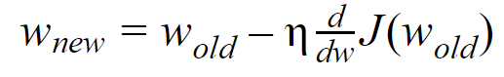
Gradient Descent

Slide 23
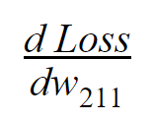
How is Loss related to w₂₁₁?

Slide 24
h₁₁
2.1
o₁₁ = 0.89
W₁₁₁ = 0.5
Input
W₁₁₂ =0.3
h₂₁
W₂₁₁ = -0.23
Output
1
2
Loss
W₁₂₁ = 0.15
1.95
o₁₂ = 0.875
W₂₁₂ = 0.83
1.106
1.793
W₁₂₂ = 0.4
W₂₁₃ = -0.56
W₁₃₁ = 0.65
h₁₃
1.05
W₁₃₂ = -0.3
o₁₃ = 0.741

Slide 25
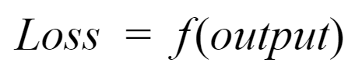
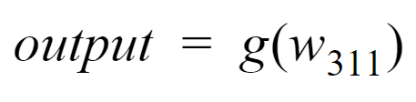
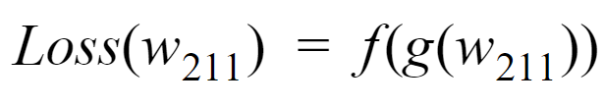

Slide 26
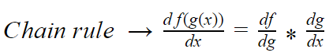
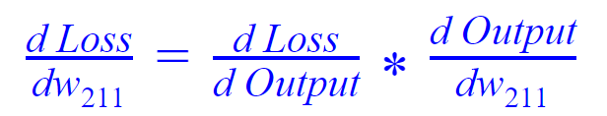

Slide 27
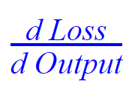
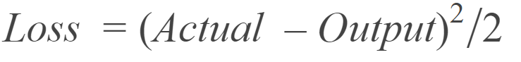
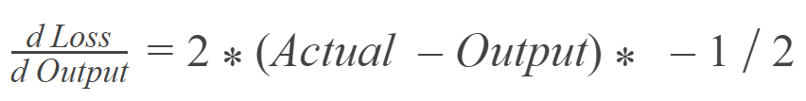
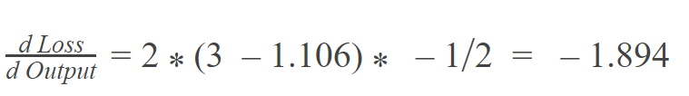

Slide 28
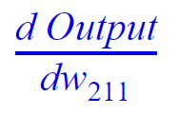
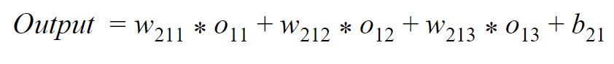
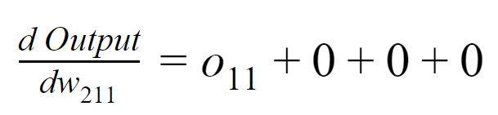
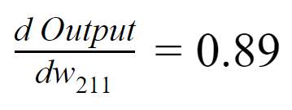

Slide 29
-1.894 * 0.89
= -1.686
What will be new value of w₂₁₁?

Slide 30
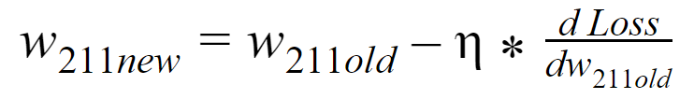
= -0.23 - 0.01 * -1.686
= -0.213

Slide 31
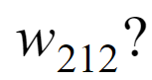
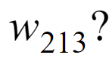

Slide 32
h₁₁
2.1
o₁₁ = 0.89
W₁₁₁ = 0.5
Input
W₁₁₂ =0.3
h₂₁
W₂₁₁ = -0.23
Output
1
2
Loss
W₁₂₁ = 0.15
1.95
o₁₂ = 0.875
W₂₁₂ = 0.83
1.106
1.793
W₁₂₂ = 0.4
W₂₁₃ = -0.56
W₁₃₁ = 0.65
h₁₃
1.05
W₁₃₂ = -0.3
o₁₃ = 0.741

Slide 33
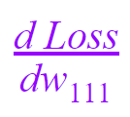
How is Loss related to w₁₁₁?

Slide 34
h₁₁
2.1
o₁₁ = 0.89
W₁₁₁ = 0.5
Input
W₁₁₂ =0.3
h₂₁
W₂₁₁ = -0.23
Output
1
2
Loss
W₁₂₁ = 0.15
1.95
o₁₂ = 0.875
W₂₁₂ = 0.83
1.106
1.793
W₁₂₂ = 0.4
W₂₁₃ = -0.56
W₁₃₁ = 0.65
h₁₃
1.05
W₁₃₂ = -0.3
o₁₃ = 0.741

Slide 35
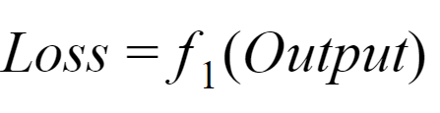
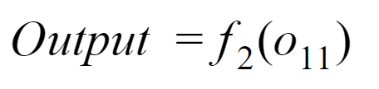
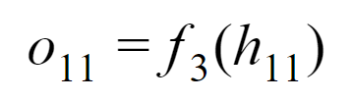
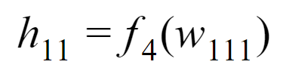

Slide 36
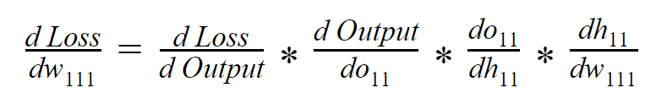

Slide 37
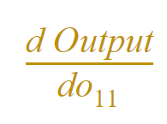
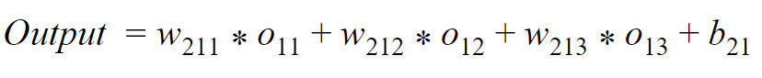
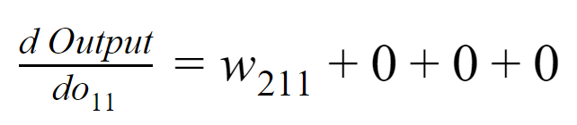
-0.23

Slide 38
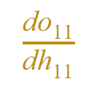
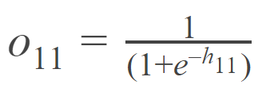
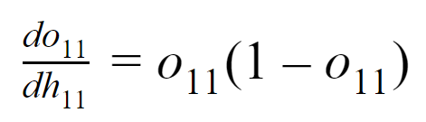
0.89*(1-0.89)
=0.0979

Slide 39
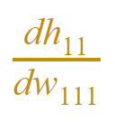
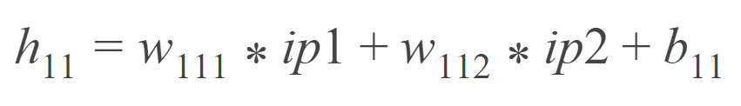
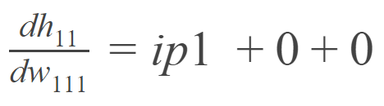
1

Slide 40
-1.894 * -0.23 * 0.0979 * 1
= 0.0426

Slide 41
New value of w₁₁₁
= 0.5 - 0.01 * 0.0426
= 0.499

Slide 42

Usually it’s not pretty
Where should we start?

Slide 43
Hidden Layer
Input
Output
What should be initial weights?

Slide 44

What can be possible issue?

Slide 45

Pick Random Numbers

Slide 46
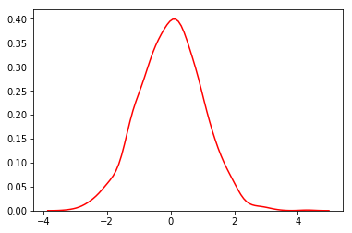
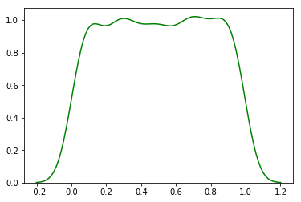
Normal Distribution
Uniform Distribution

Slide 47
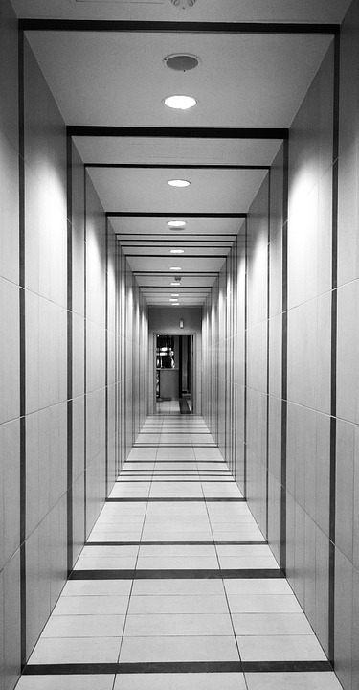
Vanishing Gradient

Slide 48

Exploding Gradient

Slide 49
Search for better Weights initialization

Slide 50
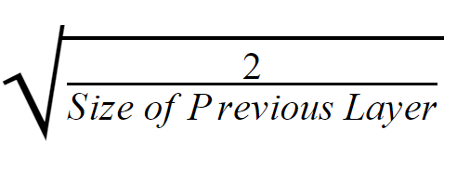
Xavier Initialization

Slide 51
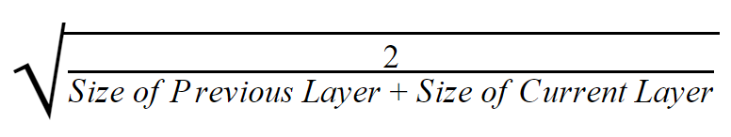
he Initialization

